Slide 1
Master Thesis Timeline
Yutong Zhao
Mid Feb
End April
May – June
July-Aug
before Aug. 29th
Thesis outline
Thesis draft
Thesis Review
Thesis Defence
Thesis submission to Graduate studies
Setup the structure of the Thesis, begin to write the contents.
Finish the first draft.
Review and refine the Thesis.
Submit to committee and start to prepare the defence.
Defence time depends on how fast the committee can finish read the Thesis.
Corrections on the thesis and submit to Graduate Studies UofM.

Slide 2
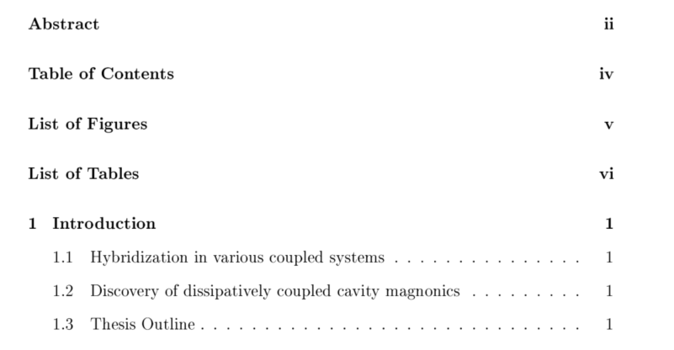

Slide 3
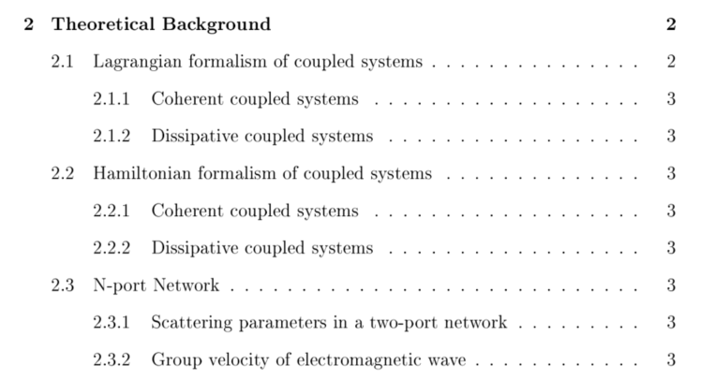
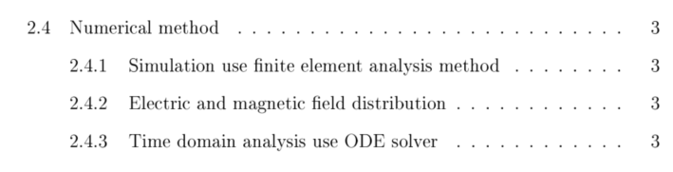

Slide 4
